Slide 1
My Mojo
My assets - idea purge and affinity map
How I create value
How I create genuinely unique value

Slide 2
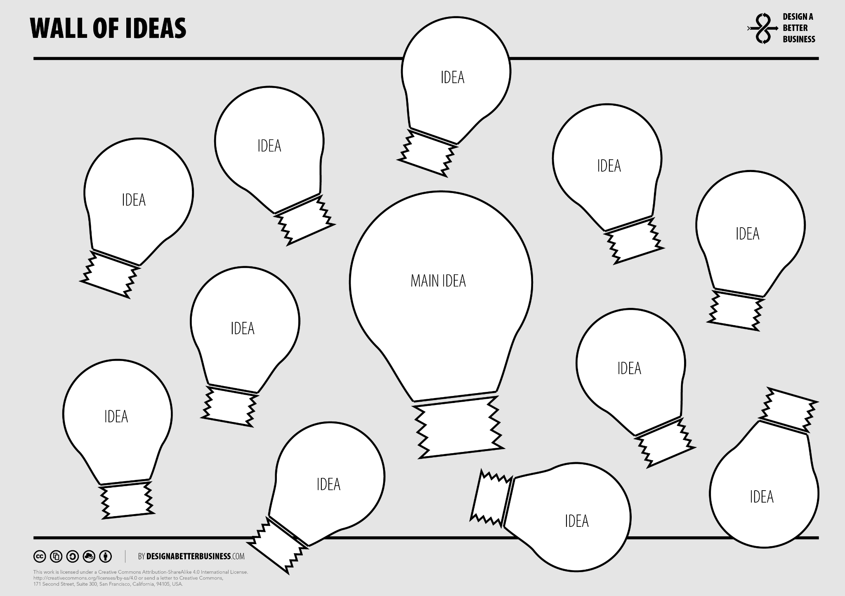
Unique

Slide 3
Impact Map
My roles
My impact

Slide 4
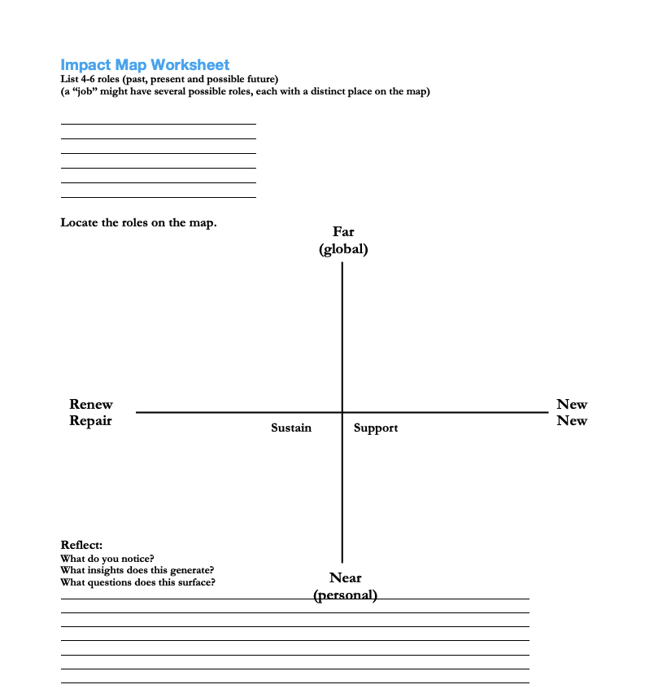

Slide 5
Day in the life
Map, share & tweak

Slide 6
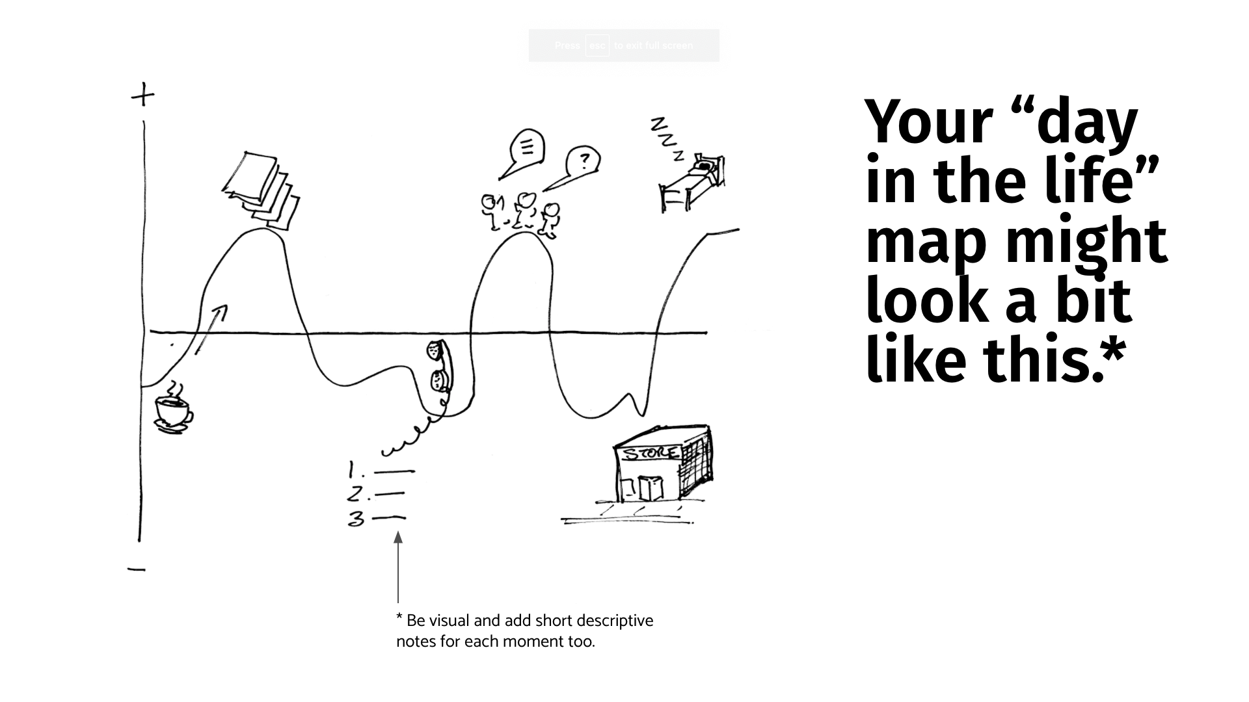
Notes:
Needs to be recreated
>ADD THIS AS A DAILY/WEEKLY PRACTICE TO DRAW THIS MAP & ADD EMPATHY MAP FOR EXTREMES (STRONG EMOTIONAL VOCABULARY). SELF- COMPASSION PROMPTS? BOUNDARY CHECK (SHOULD YOU HAVE SAID NO TO SOMETHING TODAY/THIS WEEK?)

Slide 7
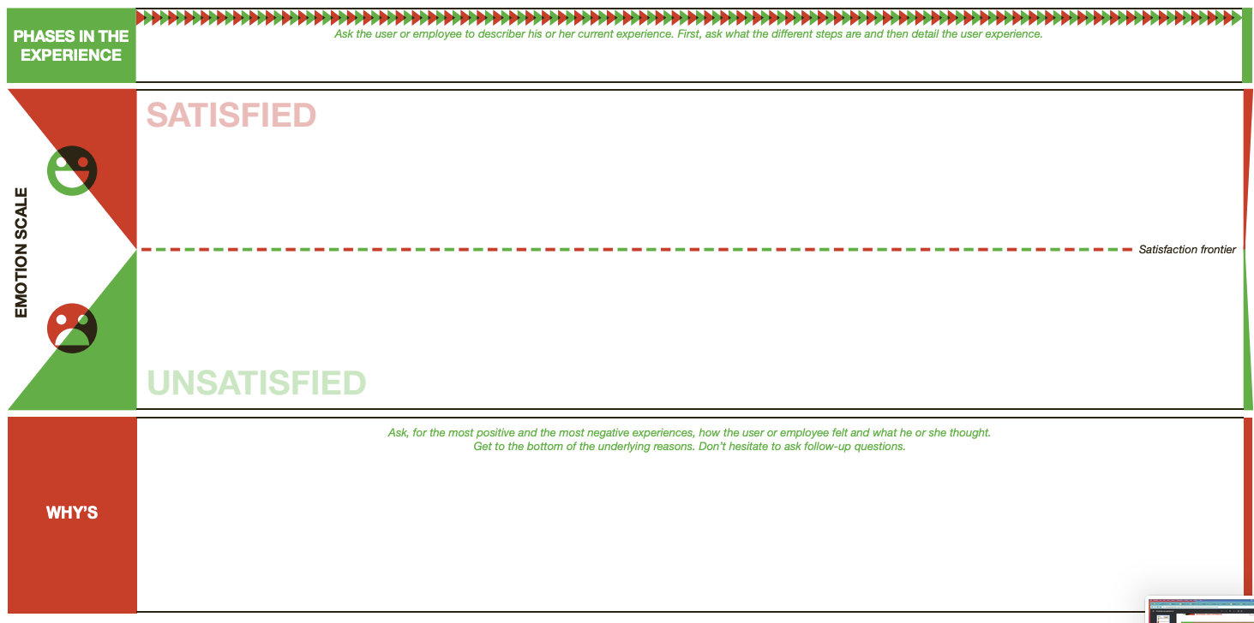

Slide 8
Get Curious
Frame the low point(s): what was the story with the lows yesterday? Or last month?
Get curious on why the highs or lows are important
Where have you made a great impact?

Slide 9
Supportive reframing
How can you help your partner?
Reword your partner’s pain point into an open-ended question that allows for multiple different options
“How can I help [partner] do [the things they want to do in that low from yesterday]?
Notes:
Questionstorming: https://howtoreframe.wordpress.com/resources/a-guide-to-questionstorming/

Slide 10
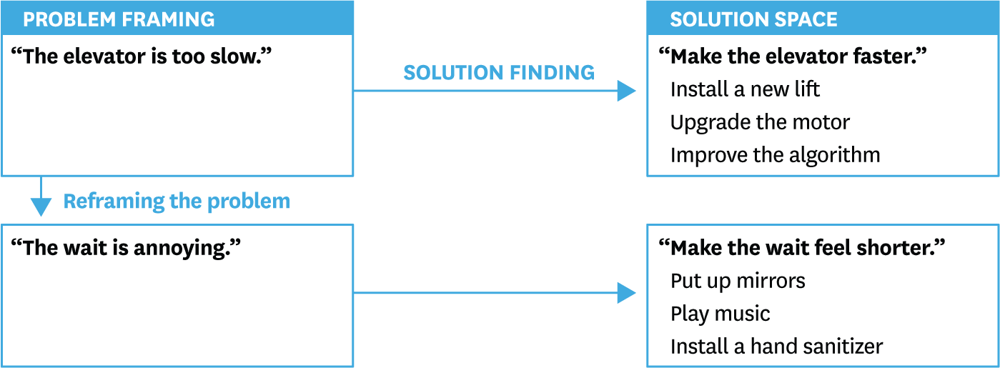
Why we reframe

Slide 11
Are you recognising your contribution as you would your child?

Slide 12
EMOTIONS

Slide 13
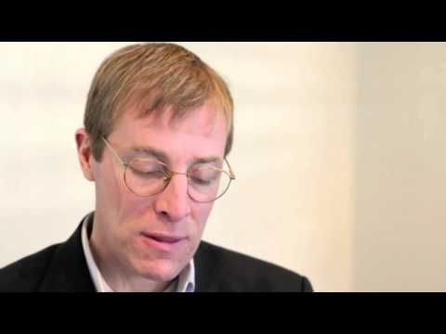
Emotional regulation
Notes:
>instrumental value of emotions to support achievement of certain objectives

Slide 14
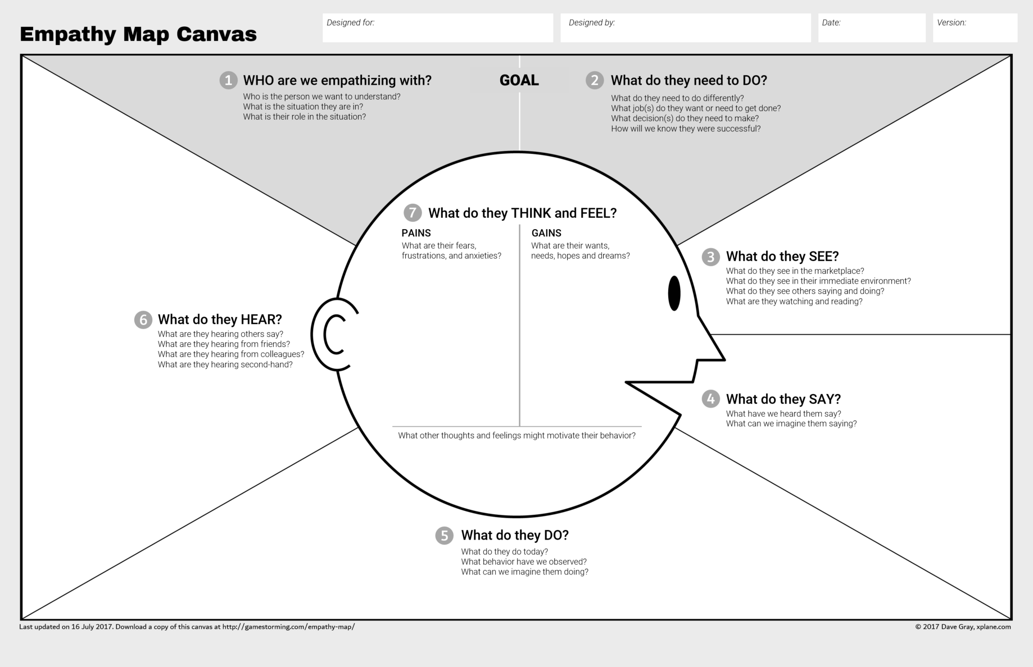

Slide 15
[Equanimity]
Notes:
Definition
Dr James Doty- resources

Slide 16
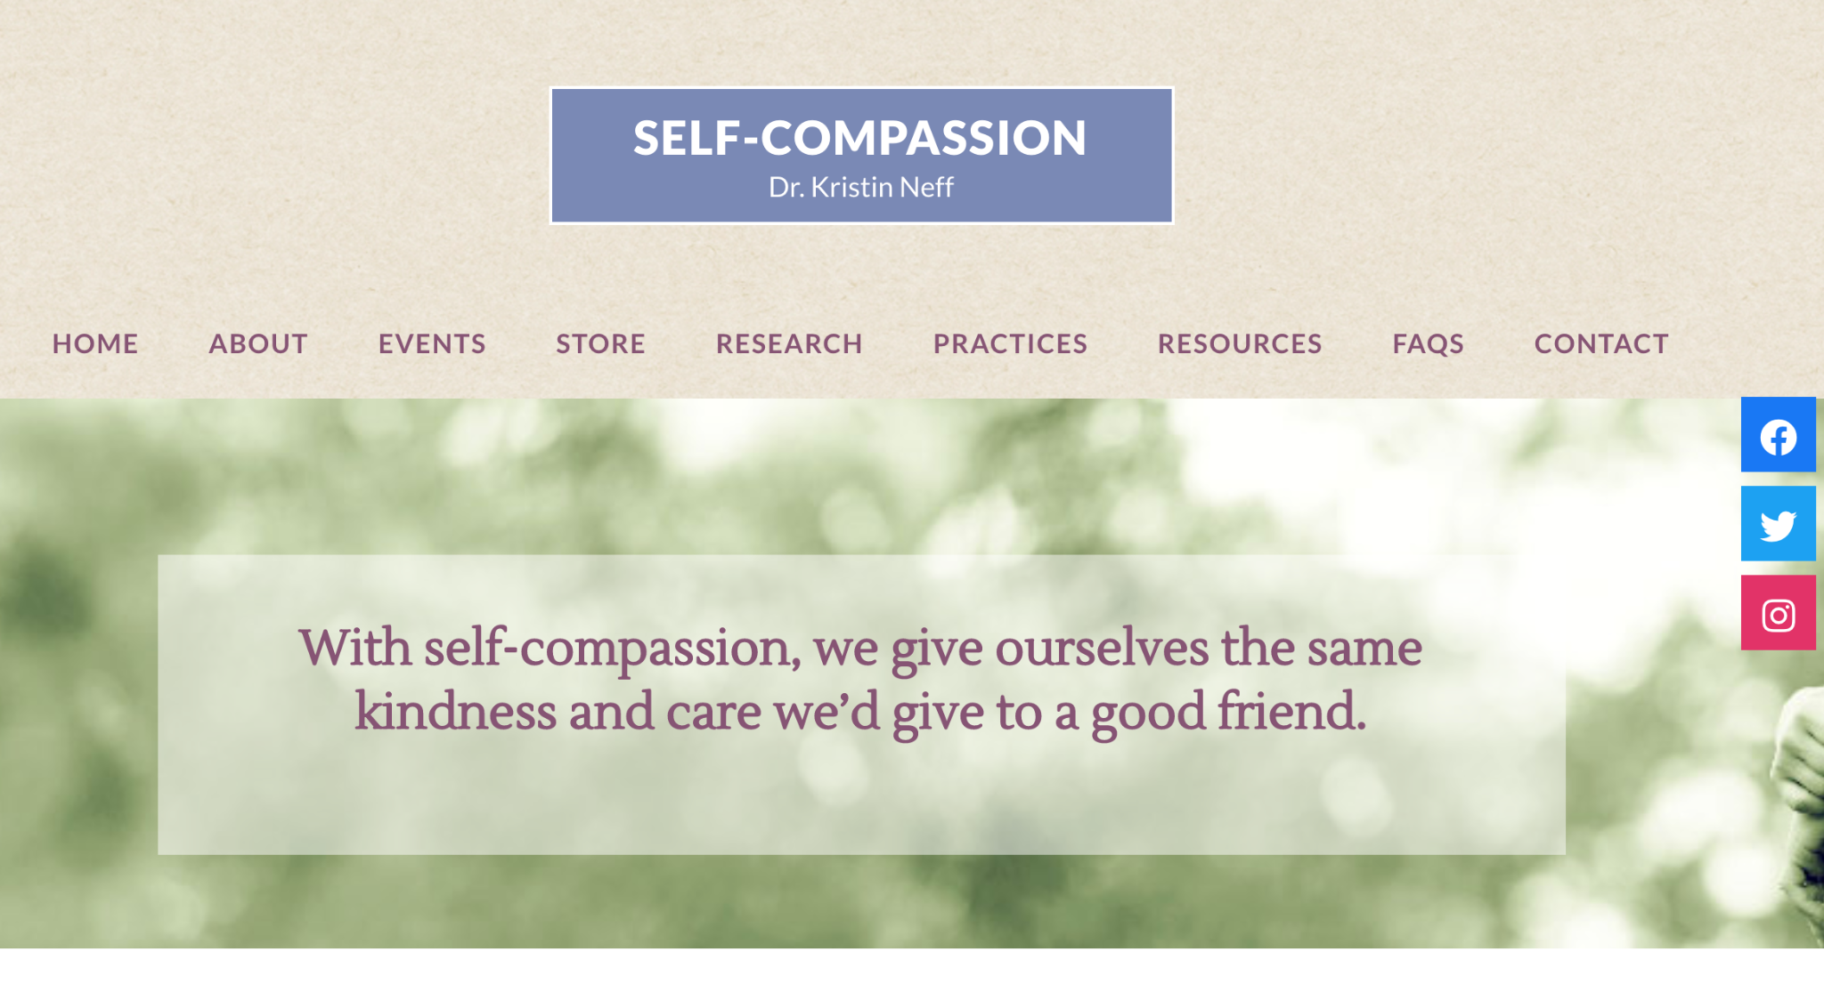
Notes:
Pick one to facilitate
https://self-compassion.org/category/exercises/#
https://self-compassion.org/wp-content/uploads/2021/06/Motivating-Self-Compassion-Break.mp3

Slide 17


